Slide 1

Problem Statement
School buses are important components of educational structure worldwide. Children’s safety on school bus trips is first and foremost. Also, catching bus on time and being on time is essential as well as tricky in the enormous traffic.
Here comes the necessity and importance of a system like Traco to track the real time location of the bus as well as providing related information to the authorities at the time of emergency.

Slide 2

FACTS N FIGURES
According to various surveys, 20 children under the age of 14 years is injured daily in the school bus accidents in India.
A RTI-based study by the foundation found that deaths while going to school rose by 39.25%.
9% of school teachers reported being threatened with injury by a student from their school.
2% students reported that they were afraid of attack or harm on the way to school or home.

Slide 3
FACTS N FIGURES
Each year school buses are used for an estimated 10 billion student trips in the nation.
Every school day 4,75,000 school buses transport 25 million children to and from schools and related activities in the country.

Slide 4
IDEA / SOLUTION
Traco provides real time bus location information for convenient bus schedules using Google Maps, integrated within the application. Various technologies like IoT, GPS, RFID, Wi-Fi etc. are used in the application. The development environment includes Android Studio to develop Android application.

Slide 5
WHY TRACO
Continuous Monitoring and Real-time Tracking
Providing safe environment to the children
Storing and updating the real time database of the vehicle like its Speed, Time, Location, and Fuel
Vehicle theft detection
Diversion of routes to save fuel
Notifications and audio alerts on collisions
Power backup in case of system failure
RFID Attendance

Slide 6
OBJECTIVE
Time management while picking students.
Children’s safety and keeping a database of students
Providing necessary information in case of emergency
To setup ID scanners
To provide real time tracking
Help in saving time and fuel

Slide 7
USERS OF THE PROJECT
School Authorities - To keep record of all buses and manage them
Transport authorities(Drivers) – To manipulate bus route to save time and avoid traffic
Parents – To monitor their wards

Slide 8
MAIN COMPONENTS
Bus Tracking Kit
Bus Security Kit
Monitoring App
Back-end Server
RFID Scanner

Slide 9
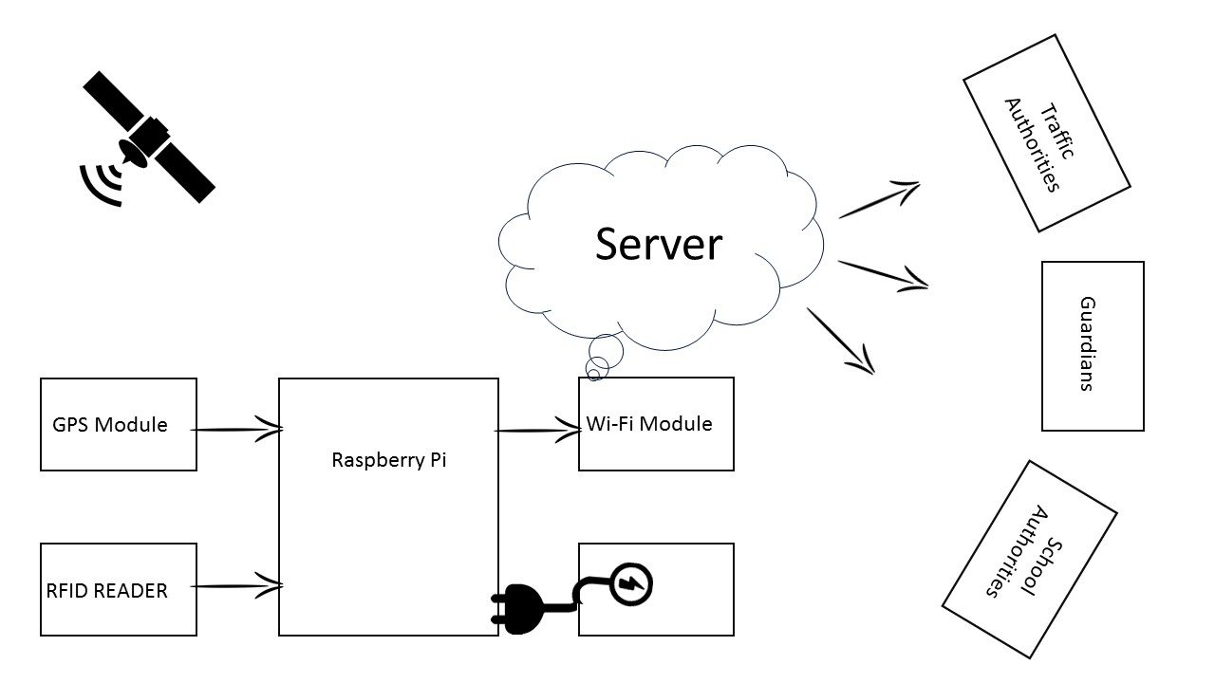
TOOLS AND TECHNOLOGIES

Slide 10

Raspberry pi 3
Credit-card sized computer
Inexpensive, Simple, Open & easy to maintain
Runs Linux, Raspbian, Fedora, Debian, Windows 10
Power Consumption < 5 watts
Full HD Video Output(1080p)
Multiple USB Ports + SD card Storage

Slide 11

WI-FI
Very Common
Widely used in indoor and outdoor environments.
General Purpose
Low Cost
Highly interoperable
Maybe not a good solution in some special conditions.

Slide 12

Global Positioning System (GPS)
Satellite based navigation system.
Based on a constellation of about 24 satellites.
NAVSTAR is the official name by DOD U.S.
Provides accurate positioning 24 hours.
No subscription fees or setup charges to use GPS.

Slide 13
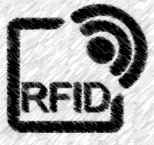
Remote Frequency identification
Widely used in Transport and Logistics
Easy to deploy: RFID tags and RFID readers
The communication range and the frequency depends on the type of technology
Line of Sight Technology

Slide 14
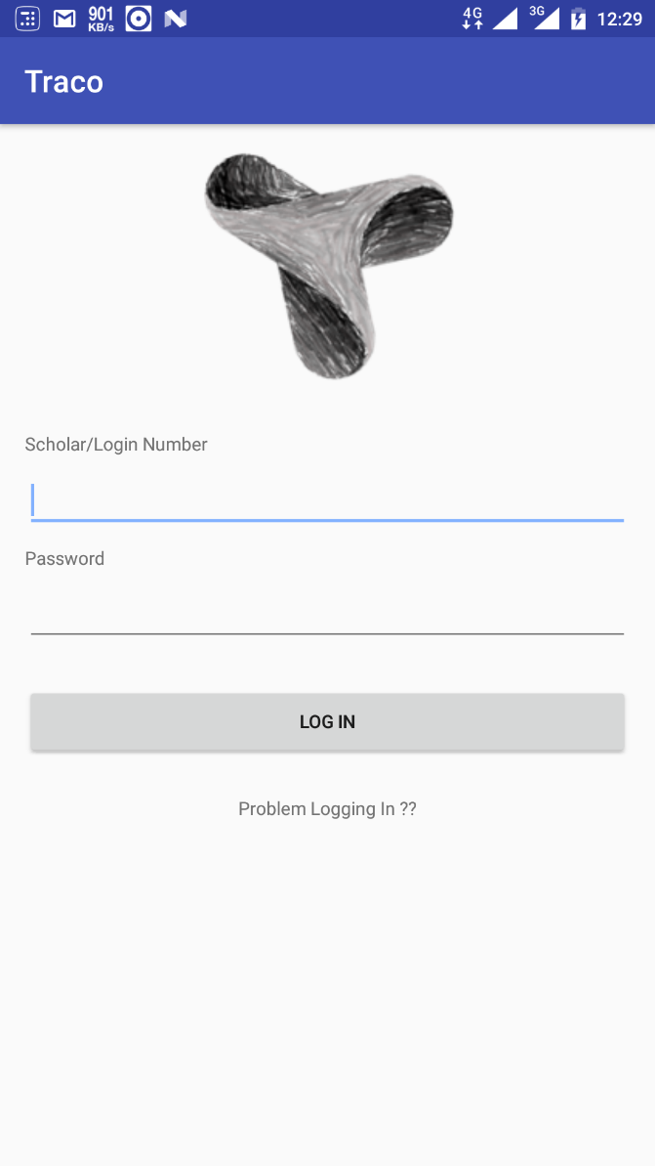
SCREENSHOTS

Slide 15
KEY LEARNING
Micro-controllers like Arduino, RFID Scanner, GPS and Wi-Fi modules
Android Development
Team Coordination
Leadership skills
Software Management
Sending Emergency Broadcast

Slide 16
CONCLUSION
In today’s world security is very much important and not guaranteed. Anything can happen anywhere anytime, all we can do is take precautions and take safety measures beforehand. The most efficient way is to monitor the process involving the risks and hence counter them.
Here Traco comes into play by taking precautions and help in being prepared early at the best.

